Slide 1
CENG 477
Introduction to Computer Graphics
Rasterization

Slide 2
Goal
After projection transformations we have a 2D scene in our viewport
Convert 2D scene (continuous) to pixels/rasters of the display device (discrete)
We refer this process as
  Rasterization, or
  Pixelization, or
  Scan conversion
We will look at rasterization process in terms of drawing algorithms for various primitives

Slide 3
Primitives
Graphic SW and HW provide subroutines to describe a scene in terms of basic geometric structures called output primitives.
Output primitives are combined to form complex structures
Simplest primitives
  Point (pixel)
  Line segment

Slide 4
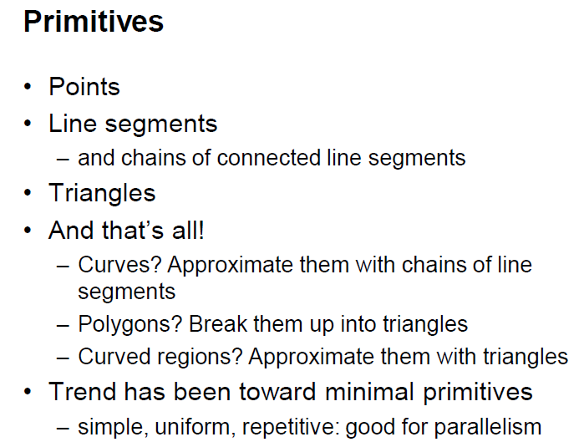

Slide 5
Rasterization
Converting output primitives into frame buffer updates. Choose which pixels contain which intensity value.
Constraints
  Straight lines should appear as a straight line
  primitives should start and end accurately
  Primitives should have a consistent brightness along their length
  They should be drawn rapidly

Slide 6
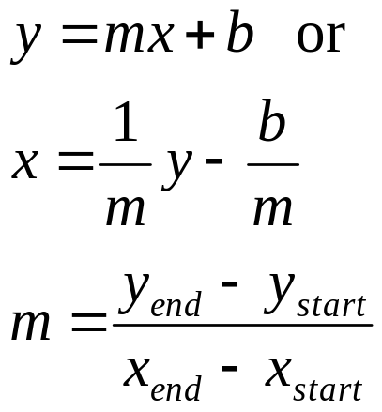
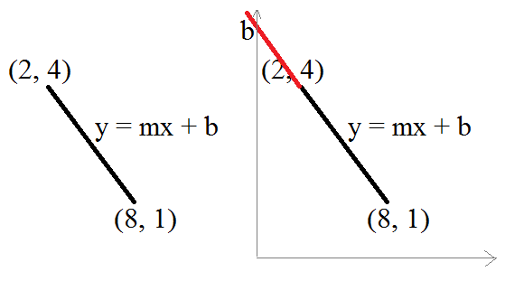
Line Drawing Algorithms
Slope-intercept line equation

Slide 7
Line Drawing Algorithms
Simple approach:
sample a line at discrete positions at one coordinate from start point to end point, calculate the other coordinate value from line equation (slope-intercept line equation).
If m>1, increment y uniformly and find x
If m≤1, increment x uniformly and find y //exchange the role of x and y
Is this correct?

Slide 8
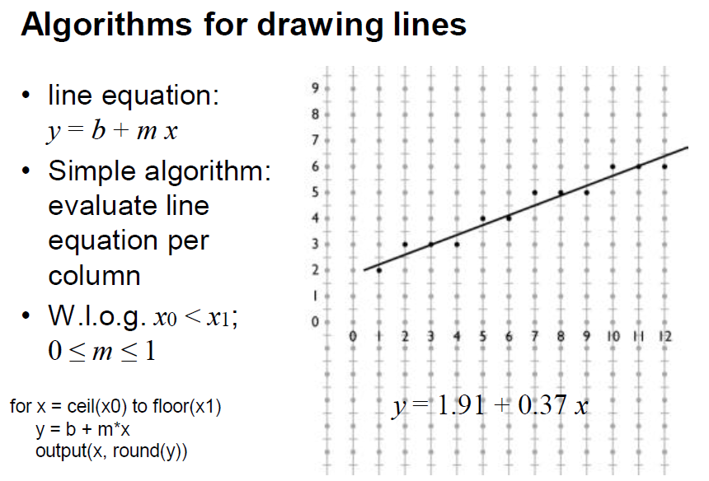
x0=.5, y0=1.91+.37/2 = 2.09
x y
1 2.28
2 2.65
3 3.02
4 3.39
5 3.76
6 4.13

Slide 9
Plotted pixels
Digitize the line with endpoints (20,10) and (30,18)
18
x y
20 10
21 10.8
22 11.6
23 12.4
24 13.2
25 14
26 14.8
27 15.6
28 16.4
29 17.2
30 18
10
20
21
22
25
30

Slide 10
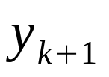


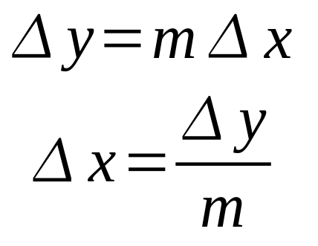
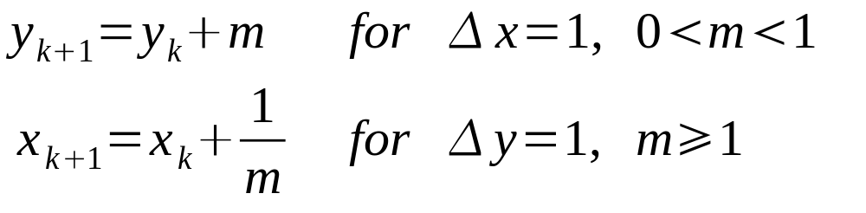
Digital Differential Analyzer
Simple approach: too many floating point operations and repeated calculations
Calculate from for a value

Slide 11
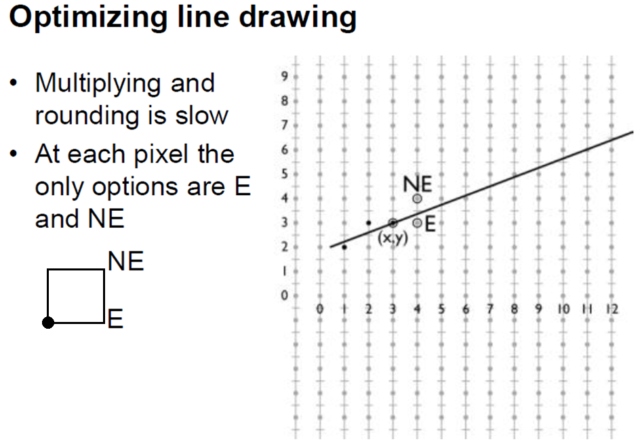

Slide 12
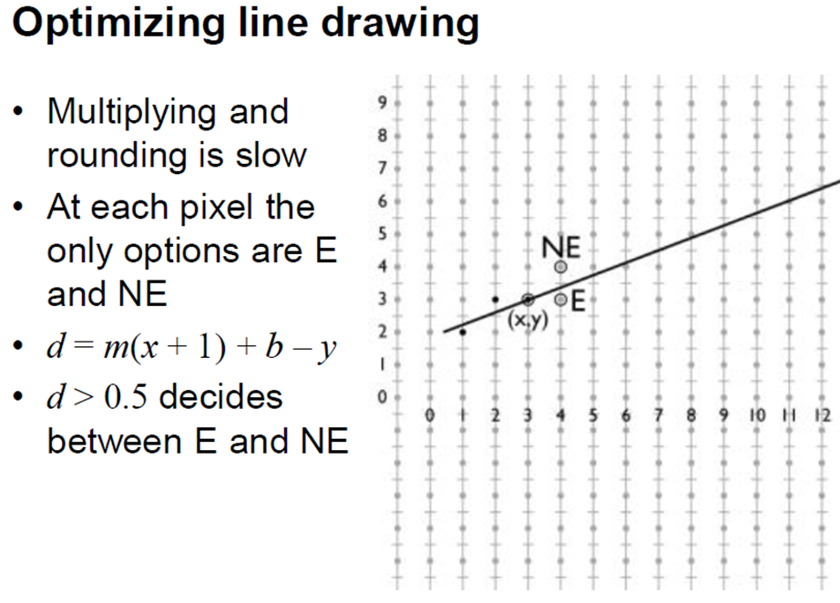
d = y_{new} – y for the initialization

Slide 13
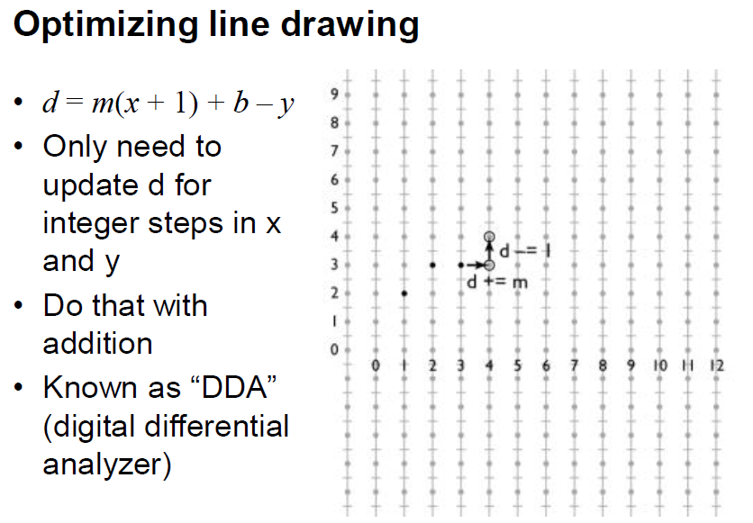
Suppose m=.3
.3 .6 (>.5) -.1 .2 .5 .8 .1 .4
y y+1 y+1 y+1 y+1 y+2 y+2 y+2

Slide 14
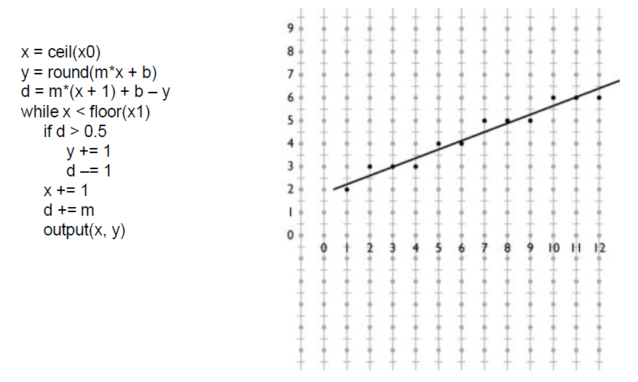
DDA Algorithm
y = 1.91 + .37x
x0=.5,
y0=1.91+.37/2 = 2.09
x y d
1 2 2.65 – 2 = .65
2 3 .65 – 1 + .37 = .02
3 3 .02 + .37 = .39
4 3 .39 + .37 = .76
5 4 .76 – 1 + .37 = .13
6 4 .13 + .37 = .5

Slide 15
DDA
Is faster than directly implementing y=mx+b. No floating point multiplications. We have floating point additions only at each step.
But what about round-off errors?
Can we get rid of floating point operations completely?
Yes
  Midpoint Line Algorithm
  Bresenham’s Line Algorithm
    Both produce the same exact result (for lines and integer circles, the midpoint formulation reduces to the Bresenham formulation)
    Both can be extended to other primitives such as circle
    We study the former as it is easier to understand

Slide 16
DDA
Is faster than directly implementing y=mx+b. No floating point multiplications. We have floating point additions only at each step.
But what about round-off errors?
Can we get rid of floating point operations completely?
Yes
  Midpoint Line Algorithm
    Idea: Find out if the midpoint b/w E-NE pixels is above or below the ideal line
  Bresenham’s Line Algorithm
    Idea: Choose the pixel closest to the ideal line

Slide 17
Midpoint Line Algorithm
Again assume lines with slopes in [0, 1] interval
Simply exchange the role of x and y for other lines

Slide 18
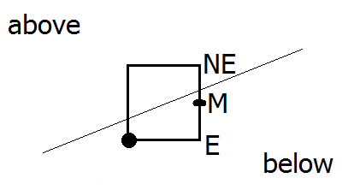
Midpoint Line Algorithm
Decision based on the midpoint of the two candidate pixels, namely E and NE
Find on what side of the line the midpoint M is
If below, NE is closer to the line (choose NE)
If above, E is closer to the line (choose E)

Slide 19
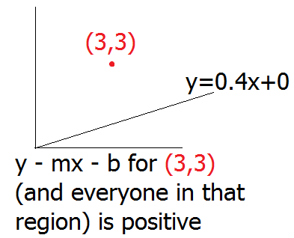
Midpoint Line Algorithm
F(x, y) = 0 → (x, y) on line
F(x, y) < 0 → (x, y) below line
F(x, y) > 0 → (x, y) above line
What is F?
observe the sign as
you go in this direction

Slide 20
Midpoint Line Algorithm
Implicit line equation y = mx + b
y - mx – b = 0
y – dy/dx x – b = 0
dy x – dx y + dx b = 0
F(x, y) = ax + by + c = 0
Hence, a = dy, b = -dx, c = b dx

Slide 21
Midpoint Line Algorithm
F(x, y) = ax + by + c = 0
Hence, a = dy, b = -dx, c = b dx
F(M) = F(xp + 1, yp + 1/2) = d
d = a(xp+1) + b(yp+1/2) + c
If d > 0, M is above the line, choose E
If d < 0, M is below the line, choose NE
(xp, yp)

Slide 22
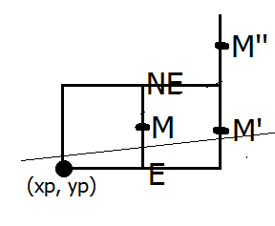
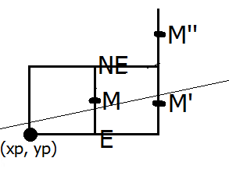
Midpoint Line Algorithm
Now we decided on E or NE; how do we change d’s?
According to this decision
consider further M’ or M’’
If we have plotted/decided E, consider M’
d_{new} = F(M’) = F(xp + 2, yp + 1/2)
d_{new} = a(xp + 2) + b(yp + 1/2) + c
d_{old} = F(M) = a(xp + 1) + b(yp + 1/2) + c
dd_{E} = d_{new} - d_{old} = a = dy //delta d when E is selected
When const dy added to d_{old} I get the desired d_{new} quickly

Slide 23
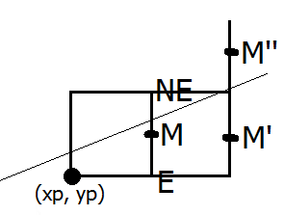
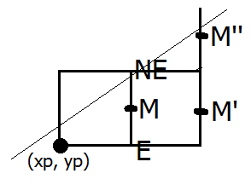
Midpoint Line Algorithm
Now we decided on E or NE; how do we change d’s?
According to this decision
consider further M’ or M’’
If we have plotted/decided NE, consider M’’
d_{new} = F(M’’) = F(xp + 2, yp + 3/2)
d_{new} = a(xp + 2) + b(yp + 3/2) + c
d_{old} = F(M) = a(xp + 1) + b(yp + 1/2) + c
dd_{NE} = d_{new} - d_{old} = a + b = dy-dx //delta d when NE selected
When const dy-dx added to d_{old} I get the desired d_{new} quickly

Slide 24
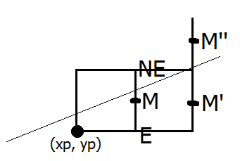
Midpoint Line Algorithm
Everything* ready to give the full algo
Need to eliminate division to stay
completely in integer arithmetic
Consider the decision variable at the starting case
d_{start} = F(x0 + 1, y0+1/2) = a(x0 + 1) + b(y0+1/2) + c
d_{start} = ax0 + by0 + c + a + b/2
d_{start} = 0 + a + b/2 //’cos (x0, y0) on the line
d_{start} = a + b/2 = dy – dx/2 //division ☹
Solution: use F(x, y) = 2(ax + by + c) ☺
  Note that this trick does not affect 0, -ve, +ve output structure of F

Slide 25
Midpoint Line Algorithm
Complete Algorithm (no floating ops)
dx=x1-x0; dy=y1-y0; d=2dy-dx;
dd_{E} = 2dy; dd_{NE} = 2(dy-dx);
x=x1; y=y1;
output(x, y);
while (x<x1)
if d < 0 d += dd_{NE}; x++; y++;
else d += dd_{E}; x++;
output(x, y);

Slide 26
Float vs Integer
The midpoint algorithm was originally developed by Pitteway in 1967
Floating point arithmetic was very expensive at the time
Does it still matter?
We implemented both algorithms and drew one million lines each between 1000 and 1400 pixels long:
  Test run on Intel Core i7 CPU at 3.2 GHz
  Compiled with g++ and –O2 option
  Basic algorithm: 7.2 seconds
  Optimized algorithm: 3 seconds
  So it still makes a difference!

Slide 27
Example
Using Midpoint Line Algorithm digitize the line with endpoints (20,10) and (30,18)

Slide 28
Example continued...
18
10
20
21
22
25
30

Slide 29
Plotted pixels
18
10
20
21
22
25
30

Slide 30
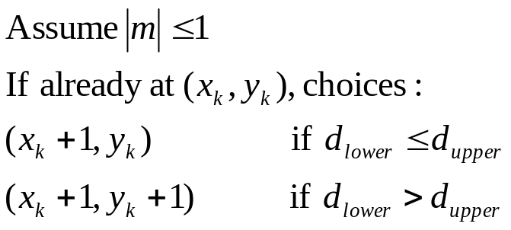
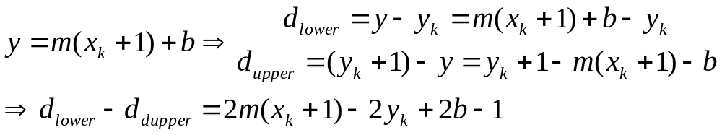
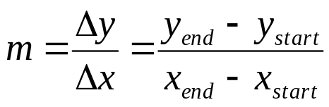
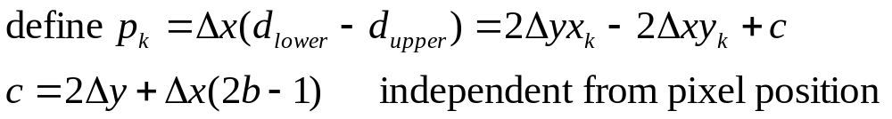
Bresenham's Line Algorithm
Same output as Midpoint Line Algorithm but different idea
Choose the pixel closest to the ideal line (not by midpoint)
y=mx+b
y_{k}+1
d_{upper}
y_{k}
d_{lower}
x_{k}
x_{k+1}
x_{k+2}
x_{k+3}

Slide 31
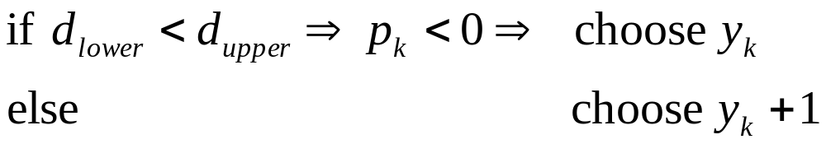
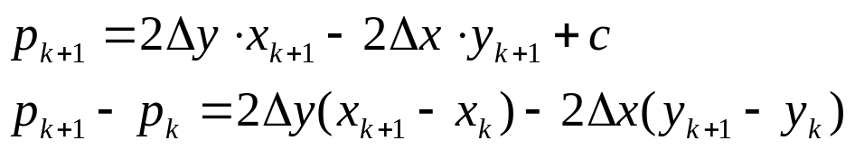
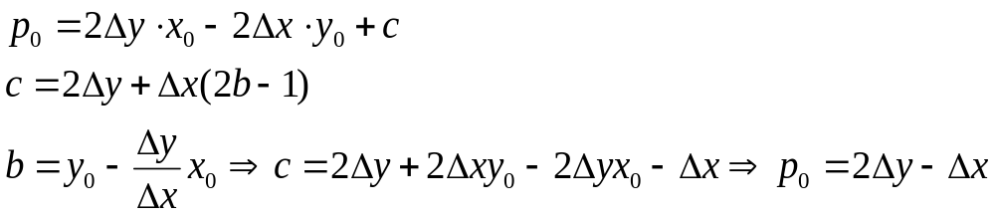
at step k+1:
0 if p_{k} was negative
1 if p_{k} was positive
to calculate p₀ at the starting pixel position (x₀,y₀)

Slide 32
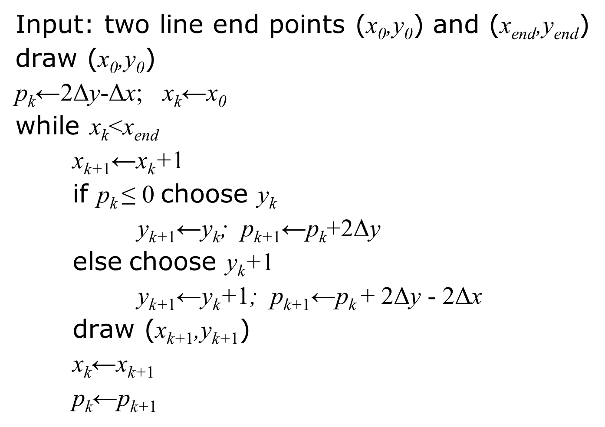
Bresenham’s Line-Drawing Algorithm

Slide 33
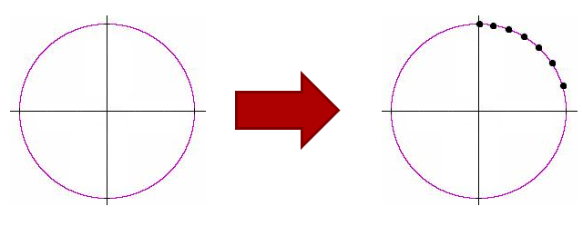
Midpoint Circle Algorithm
Drawing circle with a DDA-based approach is uncool
  Due to the uneven spacing of nonlinear circle equation:
  x² + y² = R²
  Run through x values, compute and round y //uncool

Slide 34
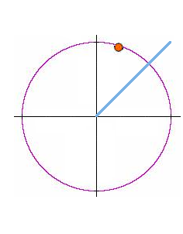
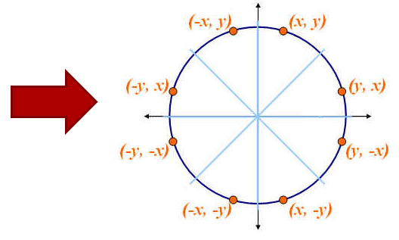
Midpoint Circle Algorithm
Break down the problem into octants
Assume 2nd octant as I can recover correspondences on other octants using 8-way symmetry

Slide 35
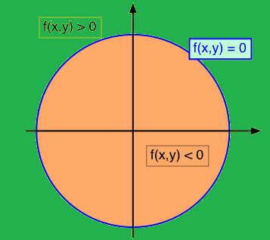
Midpoint Circle Algorithm
Decision based on the midpoint of the two candidate pixels, namely E and SE //assuming 2nd octant
Find on what side of the circle the midpoint M is
F(x, y) = 0 → (x, y) on circle
F(x, y) < 0 → (x, y) in circle
F(x, y) > 0 → (x, y) out circle
F(x, y) = x² + y² - R²

Slide 36
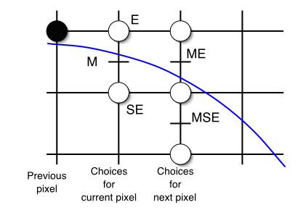
Midpoint Circle Algorithm
Decision based on the midpoint of the two candidate pixels, namely E and SE //assuming 2nd octant
Find on what side of the circle the midpoint M is
If in, E is closer to the circle (choose E)
If out, SE is closer to the circle (choose SE)

Slide 37
Midpoint Circle Algorithm
Now we decided on E or SE ; how do we change d’s?
According to this decision
consider further ME or MSE
If we have decided E, consider ME
d_{new} = F(ME) = F(xp + 2, yp - 1/2)
d_{new} = (xp + 2)² + (yp - 1/2)² - R²
d_{old} = F(M) = F(xp + 1, yp - 1/2) = (xp + 1)² + (yp - 1/2)² - R²
dd_{E} = d_{new} - d_{old} = 2xp + 3 //delta d when E selected
When const 2xp+3 added to d_{old} I get desired d_{new} quickly

Slide 38
Midpoint Circle Algorithm
Now we decided on E or SE ; how do we change d’s?
According to this decision
consider further ME or MSE
If we have decided SE, consider MSE
d_{new} = F(ME) = F(xp + 2, yp - 3/2)
d_{new} = (xp + 2)² + (yp - 3/2)² - R²
d_{old} = F(M) = F(xp + 1, yp - 1/2) = (xp + 1)² + (yp - 1/2)² - R²
dd_{SE} = d_{new} - d_{old} = 2xp - 2yp + 5//delta d when SE selected
When const above added to d_{old} I get desired d_{new} quickly

Slide 39
Midpoint Circle Algorithm
Everything* ready to give the full algo
Consider the decision variable at the starting case
(0, R) start point //2nd octant
Next midpoint: (1, R – 1/2)
d_{start} = F(1, R – 1/2) = 5/4 – R //has floating number ☹
Solution: think something similar to line case (slide 41)
  A big deal as GPUs nowadays have float arithmetic built-in? Slide26

Slide 40
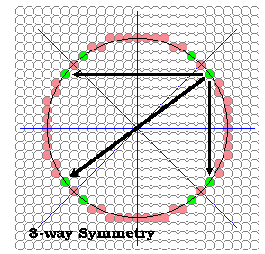
Midpoint Circle Algorithm
Complete Algorithm
x=0; y=R; d=5/4 – R;
output(x, y);
while (y>x) //in 2nd octant
if d < 0 d += 2x+3; x++; //E
else d += 2x-2y+5; x++; y--; //SE
output(x, y);

Slide 41
Midpoint Circle Algorithm
Complete Algorithm (no floating ops)
x=0; y=R; D=1 - R; //replace all d by D = d - ¼
//because increments are always integer, D< - ¼ <==> D<0
output(x, y);
while (y>x) //in 2nd octant
if D < 0 D += 2x+1; x++; //E
else D += 2x-2y+2; x++; y--; //SE
output(x, y);

Slide 42
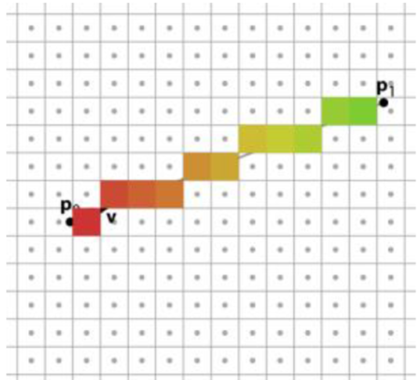
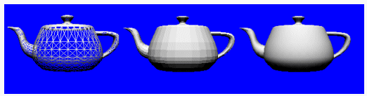
Rasterizing Triangles
Can’t we just draw each edge of the triangle (polygon) using DDA or Midpoint Line Algorithm?
  We get a wireframe model then
  We do not get the feeling of the area; coloring would help
We are looking for a drawing algorithm where we can fill the triangles with some color
  Aka scan conversion of the triangle (polygon)

Slide 43
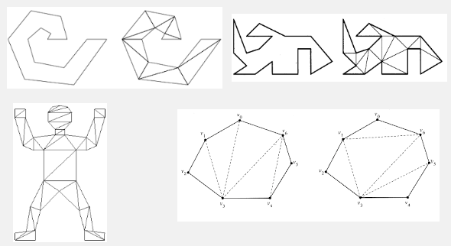
Rasterizing Triangles
Focus on triangles only because every polygon can be decomposed into triangles

Slide 44
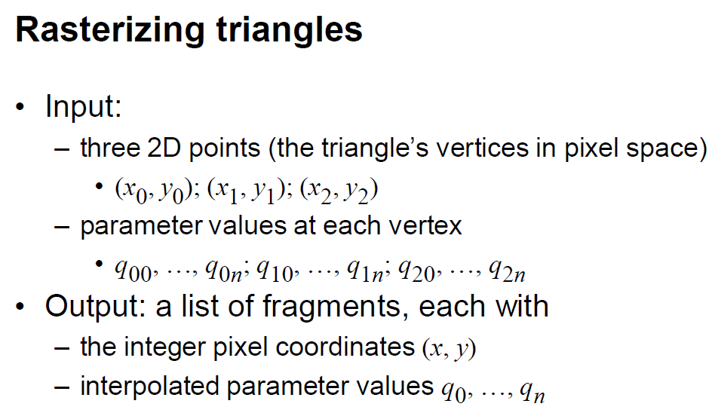

Slide 45
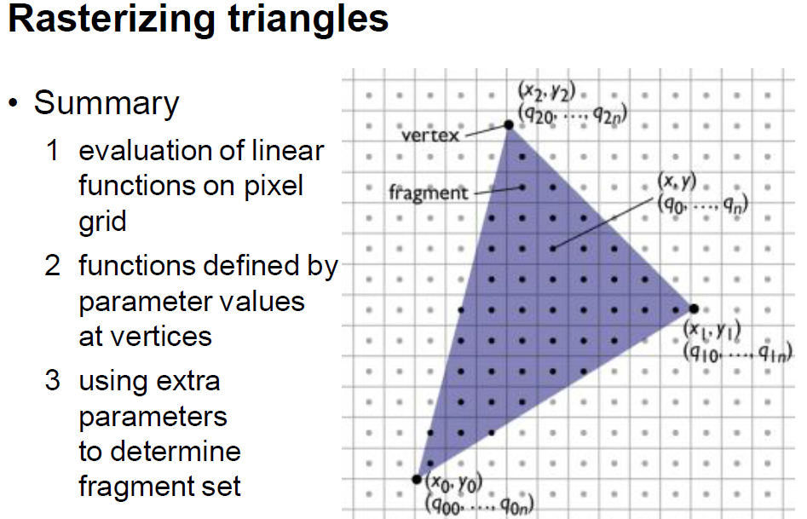
  Scanning through the bounding box of the triangle, hence the name scan conversion

Slide 46
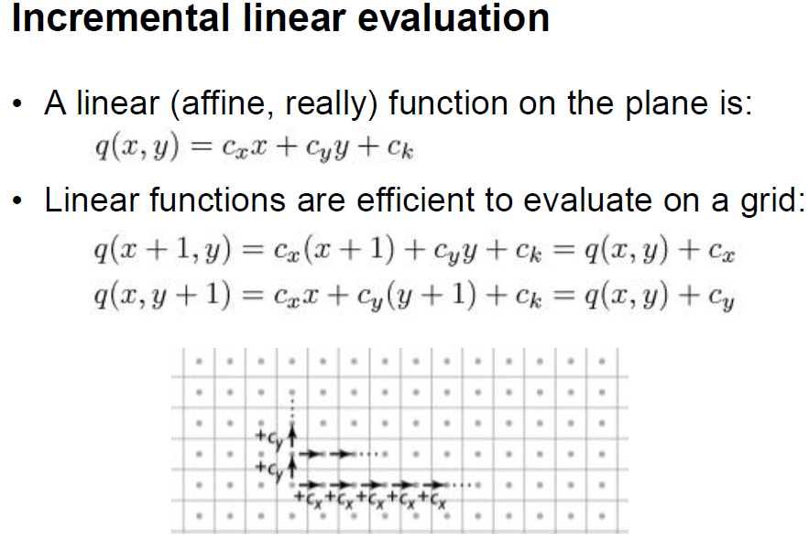

Slide 47
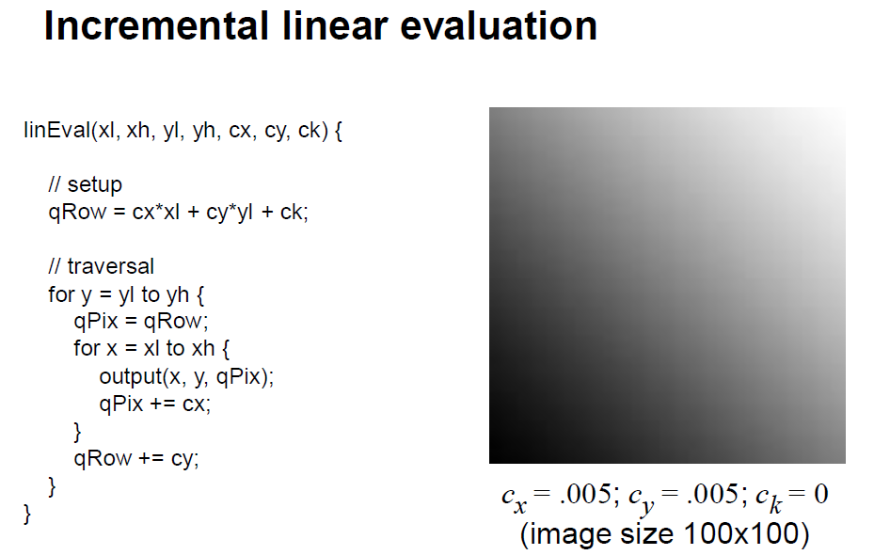

Slide 48
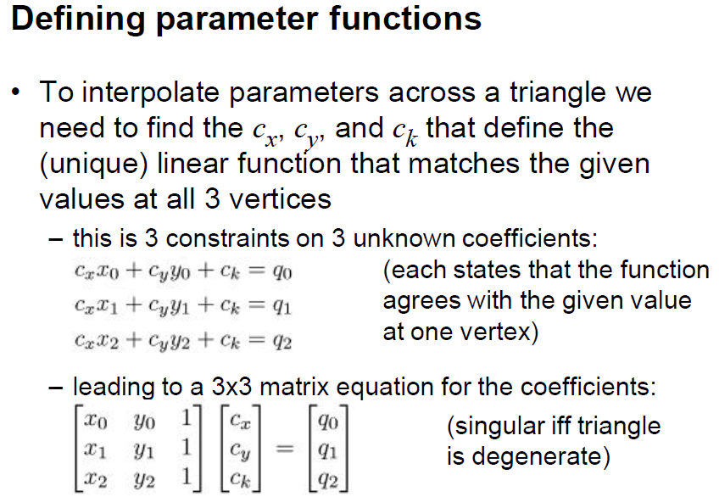

Slide 49
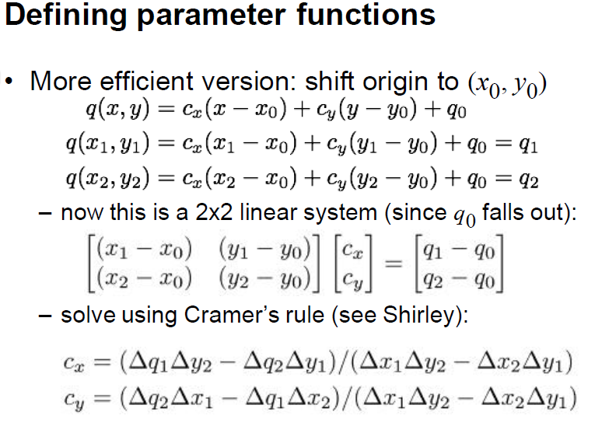
  c_{k} = q₀

Slide 50
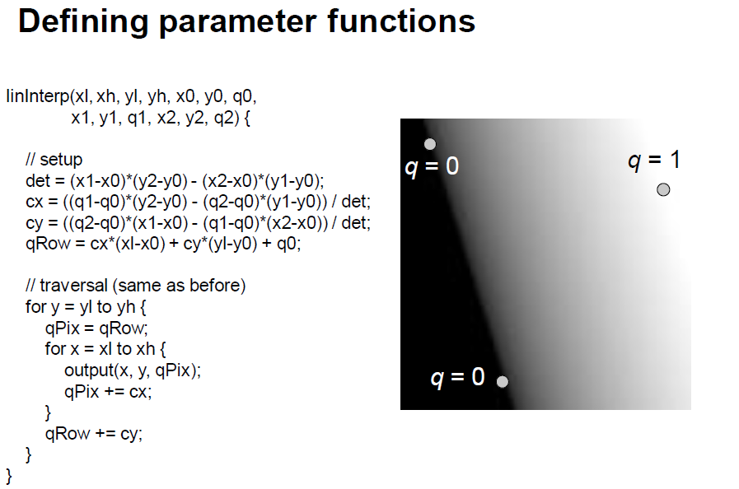

Slide 51
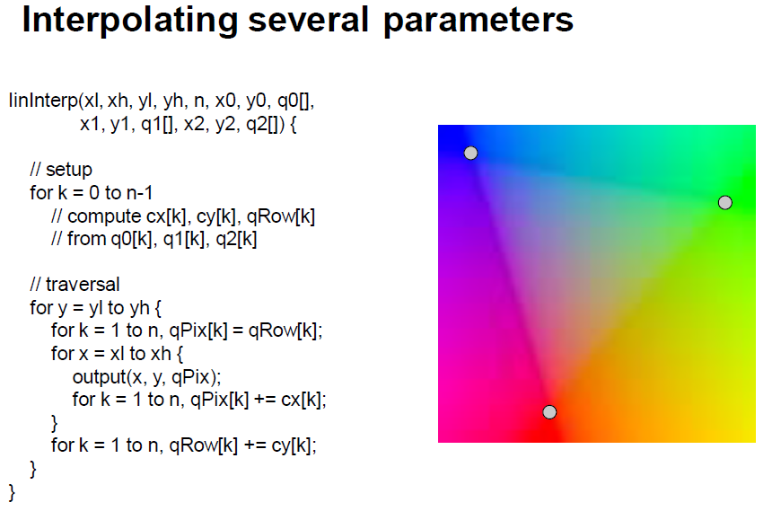

Slide 52
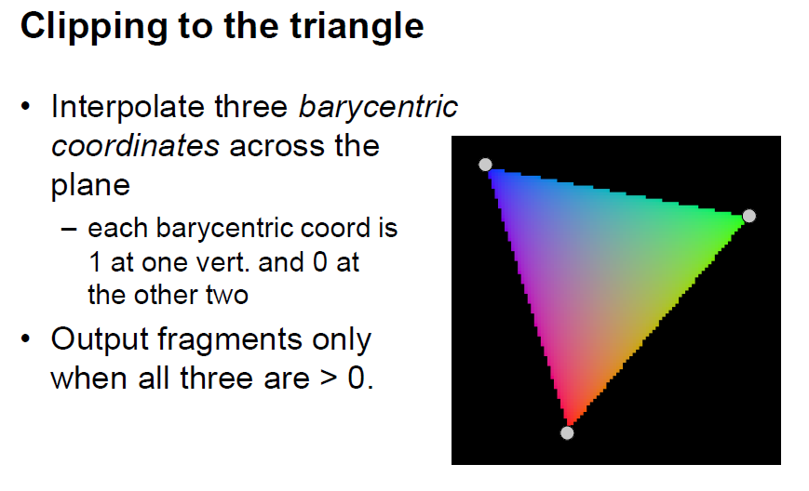

Slide 53
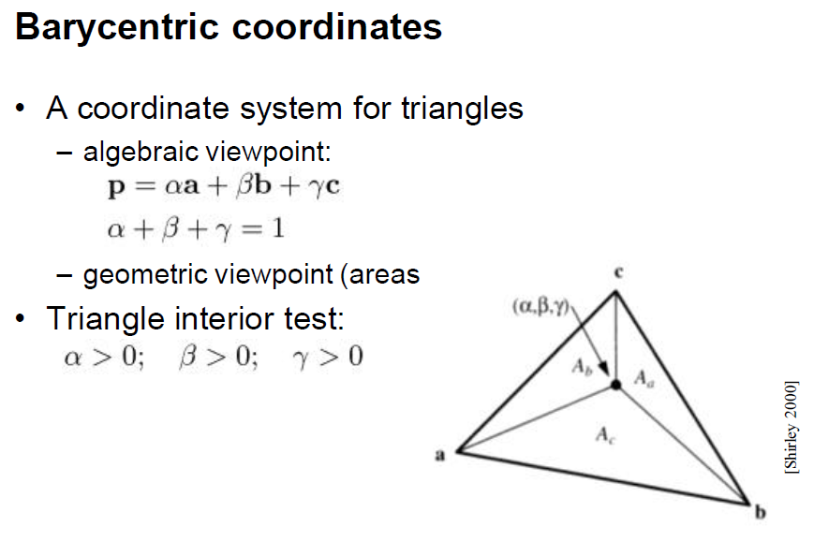

Slide 54
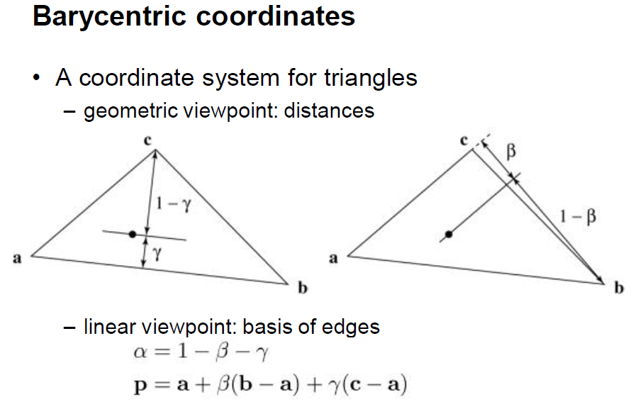

Slide 55
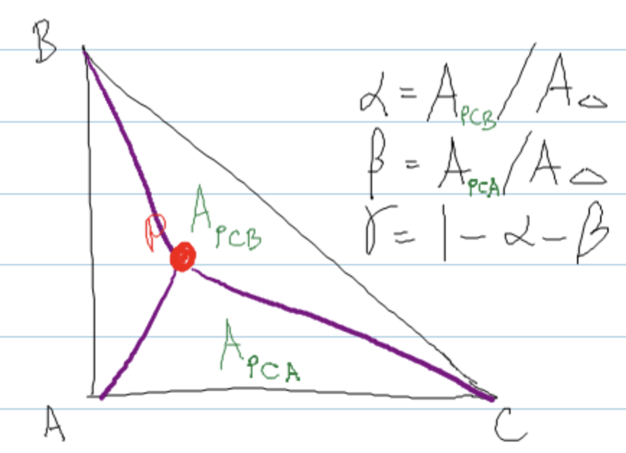
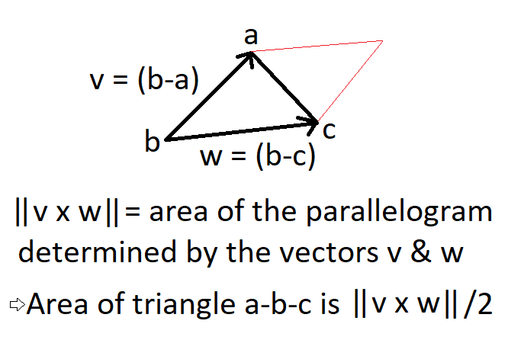
Computing the Barycentric Coordinates

Slide 56
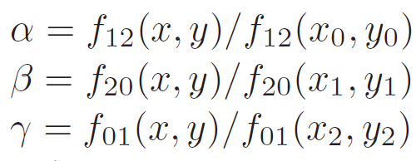
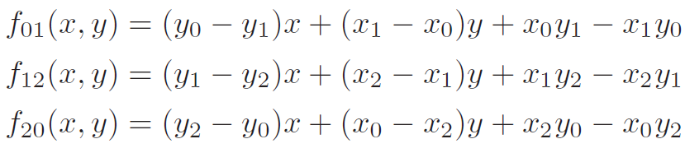
Computing the Barycentric Coordinates (more efficient)

Slide 57

Triangle rasterization algorithm
Combine this with
incremental linear
interpolation

Slide 58

Triangle Rasterization
Note that barycentric coordinates allow us to
  Make the interior test //could have been done with line eq (slide 19)
  Interpolate other attributes such as color:
So barycentric coordinates are the right way to go ☺
Line equation based interior test:
  For each pixel we visit, we must make an inside test with respect to all three edges
  We can simply plug-in the (x, y) value of the visited pixel to each line equation
  If all are negative, the pixel is inside the triangle
(x₁, y₁)
(x₀, y₀)
(x₂, y₂)

Slide 59

  More efficient than visiting bounding box pixels; here we use slope info to visit few

Slide 60
Fragment Processing
The previous stages of the pipeline (up to rasterization) is generally known as the vertex pipeline
Rasterization creates a set of fragments that make up the interior region of the primitive
The rest of the pipeline which operates on these fragments is called fragment pipeline
Fragment pipeline is comprised of several operations
The end result of fragment processing is the update of corresponding locations in the framebuffer

Slide 61
Fragment Processing
Vertices
Vertex
Pipeline
Rasterization
Fragment Pipeline
Framebuffer
Color
Buffer
Depth
Buffer
Stencil
Buffer

Slide 62

Fragment Processing
Fragment pipeline is comprised of many stages:
  Following is OpenGL’s handling of the fragment pipeline
  Different renderers may implement a different set of stages

Slide 63

Depth Buffer Test
Among these, the depth buffer test is very important to render primitives in correct order
Without depth buffer, the programmer must ensure to render primitives in a back to front order
  Known as painter’s algorithm:
From wikipedia.com

Slide 64

Depth Buffer Test
Binary space partitioning trees may be used for this purpose
However, they are costly to generate and may require splitting primitives due to impossible ordering cases:
From wikipedia.com

Slide 65

Depth Buffer Test
When memory was a very valuable resource, such algorithms were implemented
Quake3 was one of the main games that used painter’s algorithm using BSP trees
Each game level was stored as a huge BSP tree
  Read more at: https://www.bluesnews.com/abrash/chap64.shtml

Slide 66
Depth Buffer Test
Main Idea:
  At each pixel, keep track of the distance to the closest fragment that has been drawn in a separate buffer
  Discard fragments that are further away than that distance
  Otherwise, draw the fragment and update the z-buffer value with the z value of that fragment
Requires an extra memory region, called the depth buffer, to implement this solution
At the beginning of every frame, the depth buffer is reset to infinity (1.0f in practice if the depth range is [0.0f,1.0f])
Depth buffer is also known as z-buffer

Slide 67

Example
Initial state
of depth buffer
z-values of the
first triangle
Resulting
depth buffer
wikipedia.com
z-values of the
second triangle
Resulting
depth buffer

Slide 68
Depth Range
The range of values written to the depth buffer can generally be controlled by the programmer
In OpenGL, the command glDepthRange(zMin, zMax) is used
The default depth range is [0, 1]
The z-value in the canonical viewing volume (CVV), which is in range [-1, 1] is scaled to this range during the viewport transform
glDepthRange is to the z-values what glViewport(x, y, width, height) is to the x- and y-values

Slide 69

Z-Fighting
Remember that the z-values get compressed to [0, 1] range from the [-n:-f] range after projection and viewport transforms
Observe how it looks for n = 10 and f = 50

Slide 70

Z-Fighting
Remember that the z-values get compressed to [0, 1] range from the [-n:-f] range after projection and viewport transforms
Observe the same for n = 10 and f = 200

Slide 71
Z-Fighting
With a limited precision depth buffer, fragments that are close in depth may get mapped to the same z-value

Slide 72

Z-Fighting
The compression is more severe for with larger depth range
This may cause a problem known as z-fighting:
  Objects with originally different (but close) z-values get mapped to the same final z-value (due to limited precision) making it impossible to distinguish which one is in front and which one is behind

Slide 73
Z-Fighting
To avoid z-fighting, the depth range should be kept as small as possible for keeping the compression less severe
Alternatively, a floating point depth buffer can used
  Unavailable in older hardware
  Supported in all modern GPUs
Finally, the command glPolygonOffset can be used to push and pull polygons a little to avoid z-fighting

Slide 74
Scissor Test
Scissor test is a per-fragment operation that discards fragments outside a certain rectangular region
Without scissor
Scissor rectangle
Result
In OpenGL, glScissor
command is used for this
purpose
Note that this operation
is different from clipping

Slide 75

Stencil Test
While scissor test can be used to mask out rectangles, stencil test can be used to mask arbitrary fragments
Requires a different buffer known as the stencil buffer
Original
Stencil Buffer
Result
From research.ncl.ac.uk

Slide 76
Stencil Test
Typically depth and stencil buffers are combined to produce single buffer made of 24-bit depth and 8-bit stencil information for each pixel
Pixel 0
Pixel 1
D
S
D
S
D
S
…
D
S
D
S
D
S
…
D
S
D
S
D
S
…
D
S
D
S
D
S
…
…

Slide 77
Stencil Test
Stencil buffer and stencil test can also be used to implement one type of shadowing algorithms (we’ll learn this later)
Doom 3

Slide 78
Alpha Blending
Alpha blending is another fragment operation in which new objects can be blended with the existing contents of the color buffer for a variety of effects
Without blending
With blending

Slide 79
Summary
At the end of the pipeline, input vertices with connectivity information end of populating certain regions of the framebuffer
This pipeline can be implemented on the software (CPU), hardware (GPU) or both (CPU + GPU)
Vertex
Pipeline
Rasterization
Fragment Pipeline
Framebuffer
Vertices
Color
Buffer
Depth
Buffer
Stencil
Buffer

